Slide 1
Team Code- 0423
Team Name- TECHNOMANCERS
PROBLEM STATEMENT 0041:
Excessive food listing portal for avoiding food wastage. People can list the availability of excessive food on the website or mobile app. Needed people or organizations can log into the application or website to get the food for old age homes, orphanages or needy ones.
Notes:
fine

Slide 2

189,200,000
.
.
.
Million People in India are undernourished..
Powered By
Notes:
Despite sufficient food production , we are yet to address the challenge of eliminating hunger in India.

Slide 3



FooPER
“Remember that the happiest people are not those getting more, but those giving more.”
FooPER
bringing smiles along…
Powered By

Slide 4


OUR TEAM
FOOPER (Food Helper) is a voluntary, social service organization that aims to bring together other such NGOs to deliver food to the less fortunate ones at a click of a button.
F
Powered By
Notes:
He/she has surplus food, NGO connects and use that food.

Slide 5


01
02
ANDROID STUDIO
DEVELOPER TOOLS USED
FIREBASE
To develop the Front-End and processing the app.
For Backend Purposes like Authentication and Real-Time Database Management.
Powered By
Notes:
done

Slide 6

ANDROID STUDIO
Explicit Intents have specified a component which provides the exact class to be run. Often these will not include any other information, simply being a way for an application to launch various internal activities it has as the user interacts with the application.
Implicit Intents have not specified a component; instead, they must include enough information for the system to determine which of the available components is best to run for that intent.

Slide 7
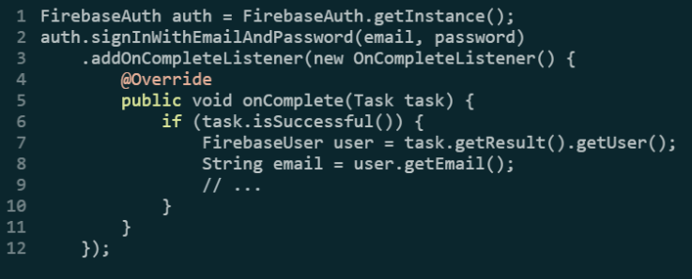
FIREBASE
Firebase Authentication aims to make secure authentication systems easy. It provides an end-to-end identity solution, supporting email and password accounts, phone authentication and more.
The Firebase Realtime Database is a cloud-hosted No-SQL database that lets you store and sync data between your users in real time.
Powered By

Slide 8

SNEAK PEAK
FooPER
Powered By

Slide 9
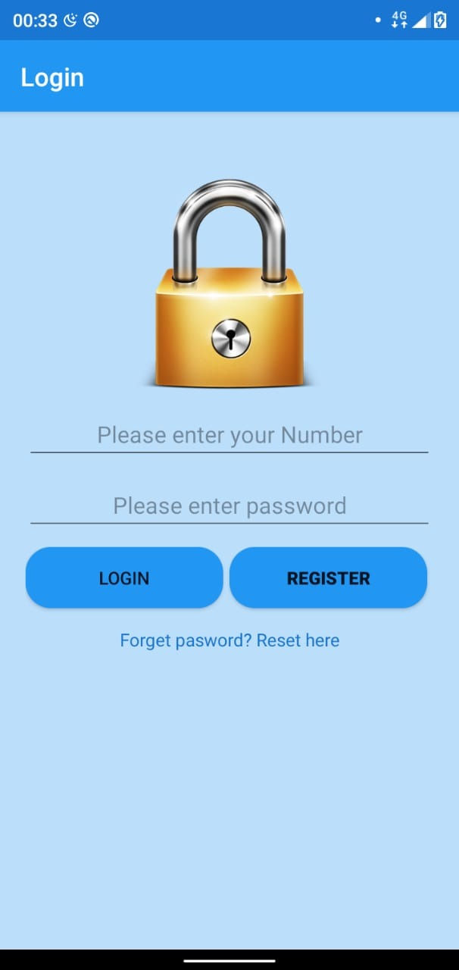
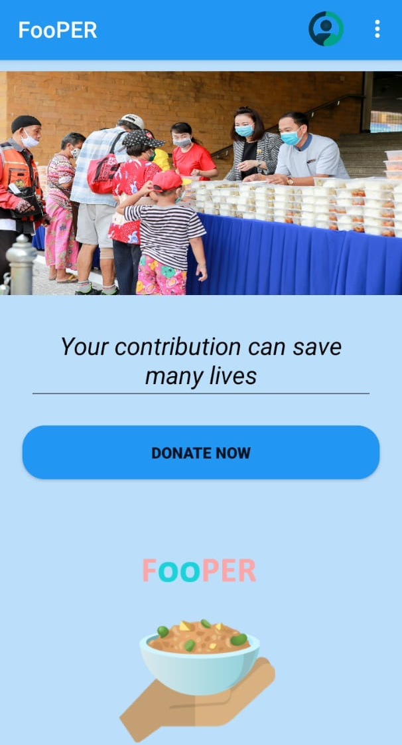
Powered By

Slide 10
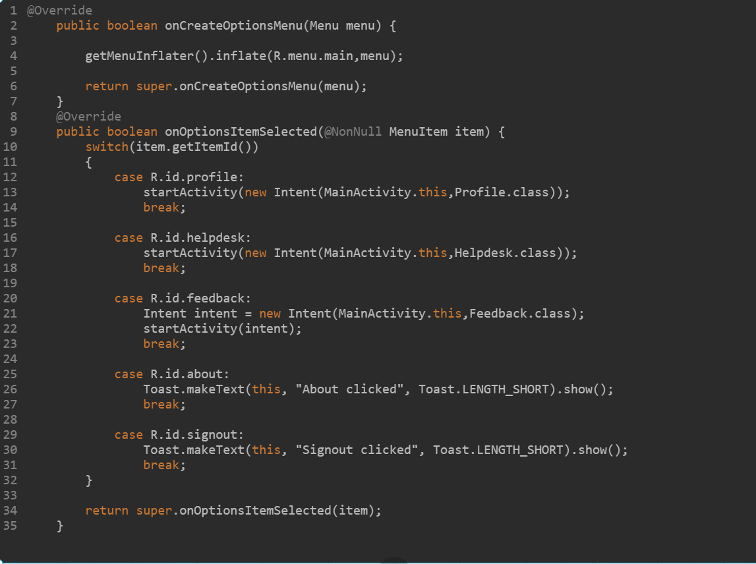
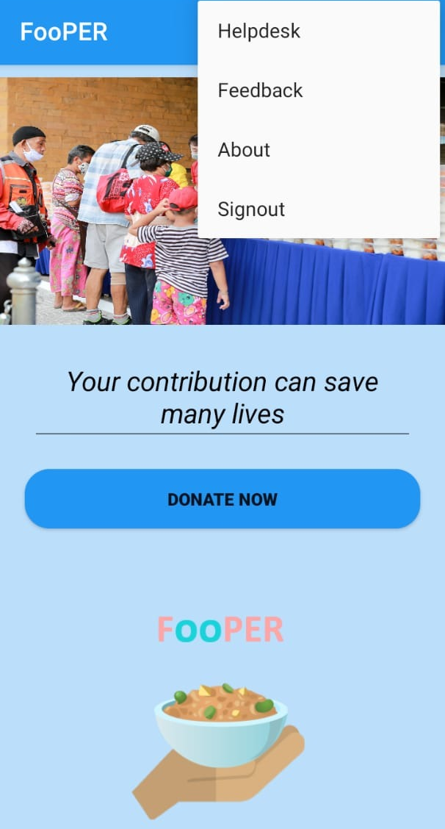
Powered By

Slide 11
Things to implement today :
As Of Now...
Backend team is ready with the registering part of the new user
We’re left with Real-Time Database connection to manage the donations
We’re ready with the front end activities
-Login Activity
-Register Activity
-Verification Activity
-Home Activity
-Profile Activity
..e.t.c
Connect Real Time Database and Maintain User and Profile.

Slide 12
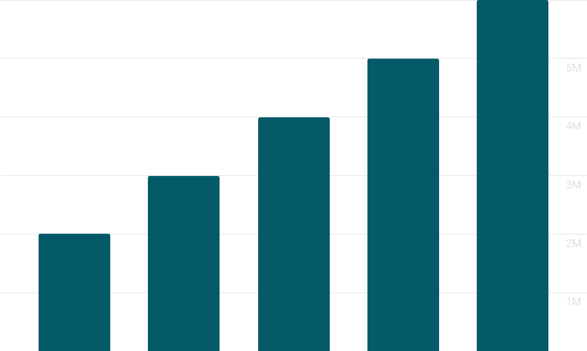
Miles to GO...
Powered By

Slide 13
FUTURE IMPLEMENTATION IDEAS
FOOPER
Providing Certificates to the regular donors.
Adding Geolocation to locate nearest NGO.
Including Restaurants for leftover food.
Powered By

Slide 14
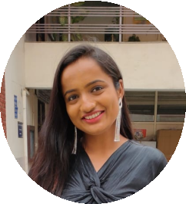
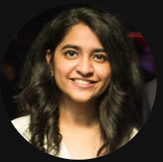
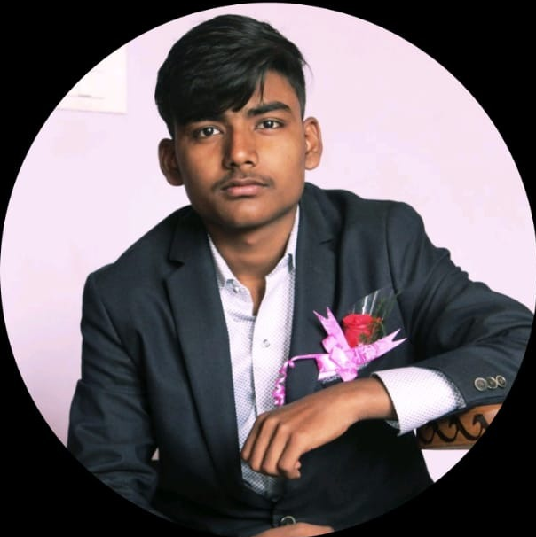
OUR TEAM
Akanksha
Akshita
Gagan
Powered By

Slide 15
Thankyou !!
Powered By

